Slide 1

MOVIE ANALYSIS..
TEAM MEMBERS:
2010030410 – L VAMSI
2010030383 – V ABHIRAM
2010030083 – K ANIRUDH
2010030174 – T SAINATH
2010039004 – MITESH CHANDRA

Slide 2
INTRODUCTION
The Internet Movie Database (IMDb) is a website that serves as an online database of world cinema.
This website contains a large number of public data on films such as the title of the film, the year of release of the film, the genre of the film, the audience, the rating of critics, the duration of the film, the summary of the film, actors, directors and much more.
Faced with the large amount of data available on this site, I thought that it would be interesting to analyze the film data on the IMDb website between the year 2000 and the year 2017.

Slide 3

OBJECTIVE
﻿﻿Determine the outline of writing movie analysis;
﻿﻿﻿Define the types of writing, and movie analysis;
﻿﻿﻿Differentiate movie analysis and movie review or critique;
﻿﻿﻿Analyse the features of a movie analysis &
Produce an effective movie analysis or movie review/critique.

Slide 4
DATA-SET USED
So we started to list all the data available on this page, understand their meaning, and especially think of a way that can recover the data on IMDb.
After having inventoried the data available on this page and understanding the meaning of each data item, we started the data selection phase, that is, the data we want to keep for my Data Science study.
Here are the data we want to keep:
Movie title
Genre of the film
Duration of the film (in minutes)
Release year of the film
Number of public votes
Public rating (score out of 10)
Critics rating (score out of 100)
Movie Gross (millions of dollars)

Slide 5
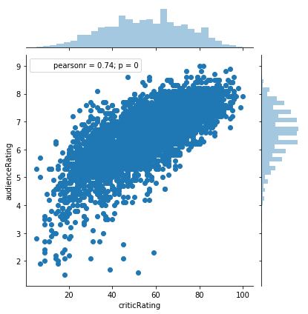
OUTPUTS
Graphical representation of audience ratings based on critics ratings between 2000 and 2017 - [JOIN PLOTS]

Slide 6
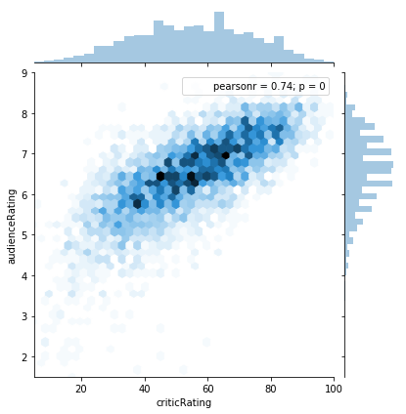
Hexagon representation of audience ratings based on critics ratings between 2000 and 2017

Slide 7
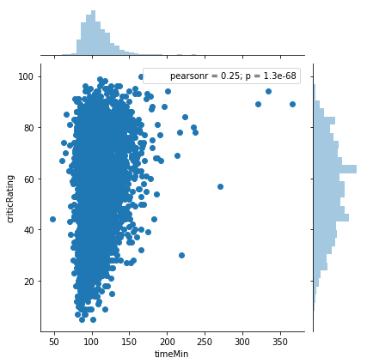
Graphical representation of the ratings of the critics according to the duration of the film between 2000 and 2017

Slide 8

TOOLS & REQUIREMENTS
Python stack: NumPy
Matplotlib
Pandas and Seaborn.

Slide 9
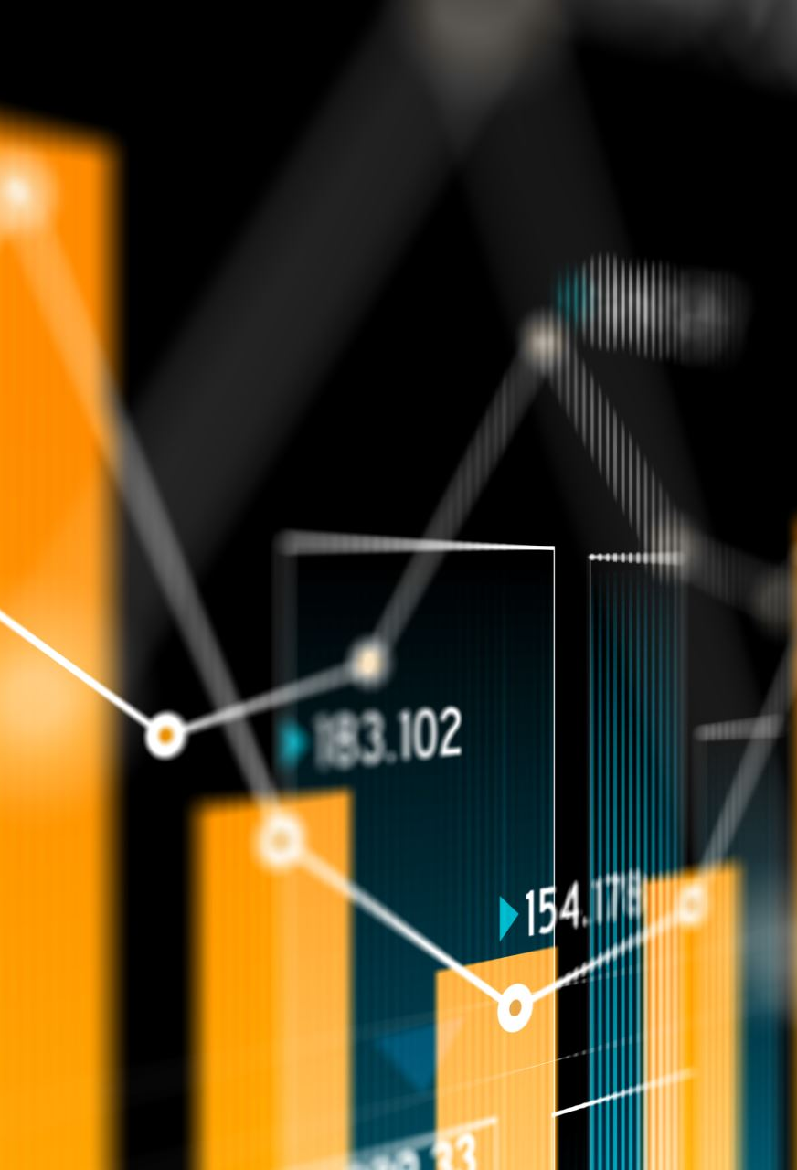
CONCLUSION
The preparation of the data, the modeling of these data, then the visualization of these data with a wide variety of graphs.
Finally the interpretation of these graphs made it possible to conduct an analysis and a global view of movies released in between 2000 and 2017.

Slide 10

THANK YOU!!

